Slide 1
Knowledge transfer
Greg Solovyev, Staff Engineer, Zimbra Admin Console

Slide 2
Table of Contents
A bit of background
UI layout
XForms
Metadata
Code structure
Data abstraction
Handling events
Localization
Browser support
Themes
Admin Extensions Framework
Overview
UI components
Server components
Where are they hiding?
FOSS vs. Network extensions
Dev environment
Building
Debugging
Areas to focus on next

Slide 3
Background
Why this section?
To help you find bugs
8 years of code
before jQuery, SproutCore, Dojo, Cappuccino and most other contemporary AJAX frameworks
8 different engineers
no sinlge coding convention
Started as a side project of UI team
Initial framework not optimized for the use case
Framework overhaul in GNR (Greg and Charles)
XForms v2 (separate from mail UI)
UI overhaul in Iron Maden (Charles’ team in China)

Slide 4
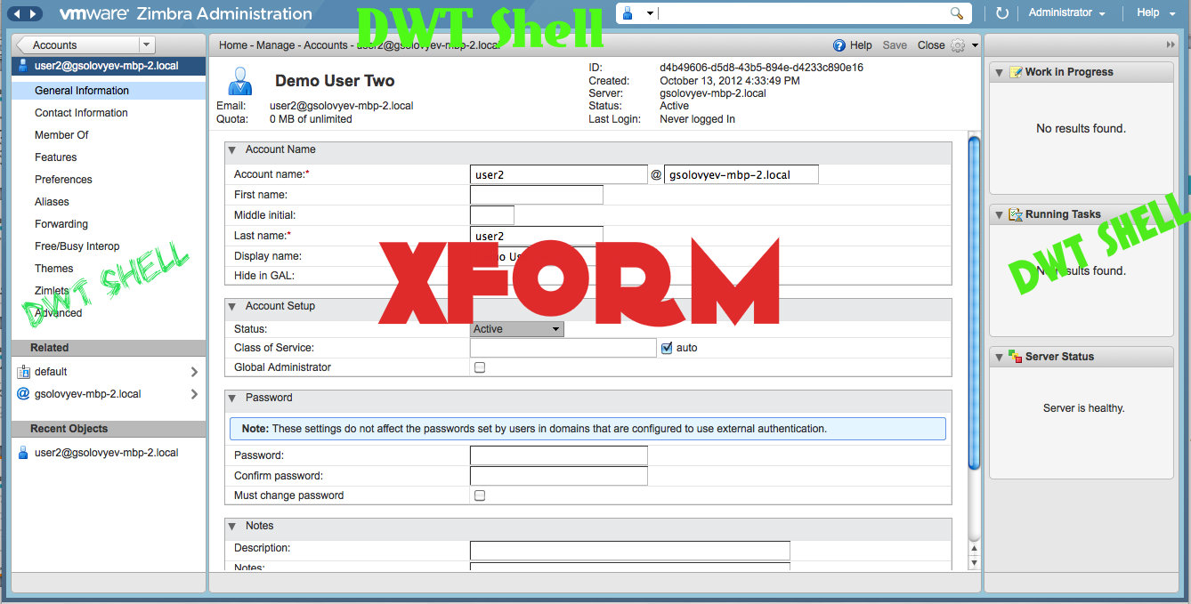
Where are XForms?

Slide 5
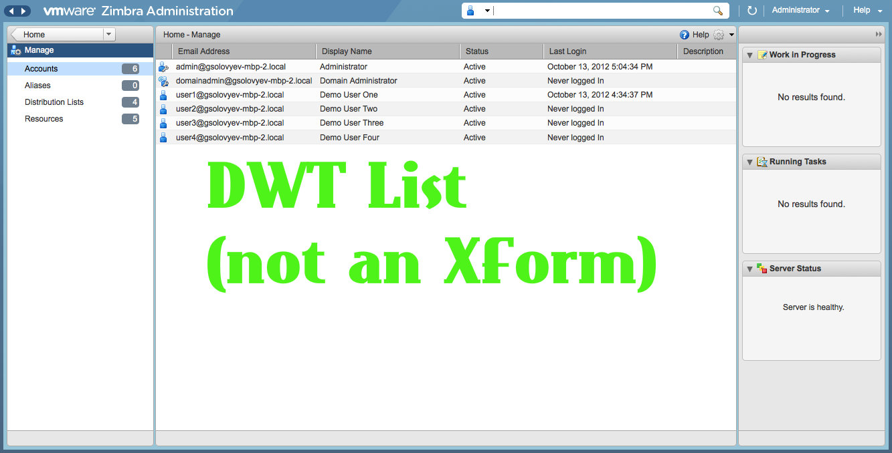
Where are XForms?

Slide 6
XForms
Metadata
XForm
XModel
What’s an XForm?
DWT control that can render a bunch of complicated data forms using HTML elemtns and other DWT Controls (via DWT-XForm item adapters)
Layout and data binding defined by metadata
Data behavior rules defined by meta data (XModel)

Slide 7
XForms
Admin UI
XForms
DWT
XForms are for rendering forms:
Rendering (XForm, XFormItem)
Layout
UI abstraction
DWT widgets
HTML form elements
Data binding (XModel, XModelItem)
Apply data to UI elements
Data updates
Data changes
Dependency rules
Event handling

Slide 8
XForms Metadata
XForms rendering:
Classes that inherit from XFormItem implement the rules for rendering metadata.
Examples of metadata for defining a simple form element:
1) Textfield
{ref:ZaAccount.A_firstName, type:_TEXTFIELD_, label:ZaMsg.NAD_FirstName}
2) Button with a custom label, a custom icon, an activation handler and a rule that that enables this button when an item is selected in another form element:
{type:_DWT_BUTTON_, label:ZaMsg.Previous, width:75, icon:"LeftArrow", disIcon:"LeftArrowDis”,
enableDisableChangeEventSources:[ZaAccount.A2_nonMemberList + "_offset"],
enableDisableChecks[[ZaAccountMemberOfListView.shouldEnableBackButton,ZaAccount.A2_nonMemberList]],
onActivate:"ZaAccountMemberOfListView.backButtonHndlr.call(this,event, ZaAccount.A2_nonMemberList)”
}

Slide 9
XForms Code Structure
Where are XForms?
ZimbraWebClient/WebRoot/js/ajax/dwt/xforms/
XForm.js
XFormItem.js
XModel.js
XModelItem.js
XFormGlobal.js

Slide 10
XForms Code Structure
XForm.js (XForms “class”)
Draws the form container div and table that contains all the elements
pushes data (instance) down to form elements (XFormItems)
XForm.prototype = new DwtComposite;
XForm.prototype.constructor = XForm;
Key methods:
XForm.prototype.draw
XForm.prototype.outputForm
XForm.prototype.outputItemList
XForm.prototype.setInstance

Slide 11
XForms Code Structure
XFormGlobal.js
A bunch of utility methods.
Key methods that manage global object references:
XFG.assignUniqueId
XFG.getUniqueId
XFG.cacheGet

Slide 12
XForms Code Structure
XFormItem.js (XFormItem “classes”)
Each form element is defined by an XFormItem class
Most XFormItem classes are defined in XFormItem.js
What does an XFormItem class do?
draws a form element (<input> or <div>)
or places a DWT control into the form
declares metadata handles
fires UI events
handles UI events
handles data events
fires data evnets
renders the data by picking it from an data instance object
Types of XFormItem
HTML element
DWT widget
Group (several XFormItem elements related by layout)
Composite (several XFormItem elements rendering single data element)

Slide 13
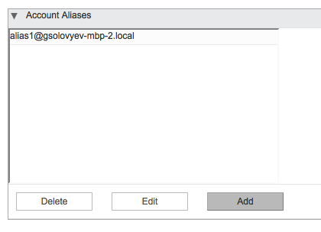
XForms Code Structure
XFormItem.js (XFormItem “classes”)
Base XFormItem class
defines a basic HTML element
Textfield_XFormItem
defines a form element rendered as <input> tag
Dwt_Adaptor_XFormItem
adaptor for placing a DWT widget on XForm-based form

Slide 14

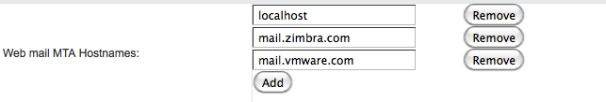
XForms Code Structure
XFormItem.js (XFormItem “classes”)
Group_XFormItem
combine several form items for layout purpose: show/hide together, arrange in a specific way, tabs
Repeat_XFormItem
show a form item (or several form items) multiple times. Often used for multi-value attributes such as hostnames assigned to a server, list of installed services, etc

Slide 15
XForms Code Structure
XFormItem.js (XFormItem “classes”)
Switch_XFormItem (_SWITCH_) and Case_XFormItem (_CASE_)
_SWITCH_ is a special kind of _GROUP_ where only one item in the group can be visible at a time
_CASE_ is an element inside _SWITCH_
used for all tabbed forms
each tab is a _CASE_
tabbed view is a _SWITCH_

Slide 16
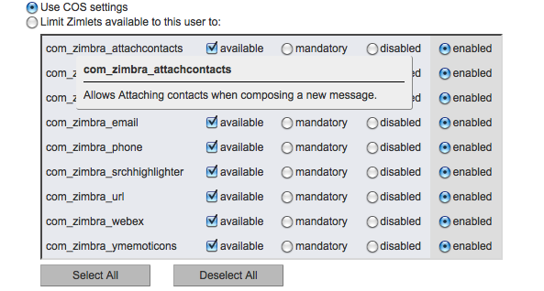
XForms Code Structure
XFormItem.js (XFormItem “classes”)
Composite_XFormItem
Similar to Group, but the form items are rendering a single data property: host/port combination (two text fields), a data property that has a default (fall back) value

Slide 17
XForms Code Structure
Example of declaring an XFormItem class:
Textfield_XFormItem = function() {}
XFormItemFactory.createItemType("_TEXTFIELD_", "textfield", Textfield_XFormItem, XFormItem);
Textfield_XFormItem.prototype.containerCssClass = "xform_field_container";
Textfield_XFormItem.prototype.visibilityChecks = [XFormItem.prototype.hasReadPermission];
Textfield_XFormItem.prototype.enableDisableChecks = [XFormItem.prototype.hasWritePermission];
[...]
//appends this form item’s HTML code to “html”
Textfield_XFormItem.prototype.outputHTML = function (html, currentCol) {
[...]
html.append(“<input autocomplete='off' id=\"", this.getId(),
"\" type=\"", this._inputType, "\"",
this.getCssString(), this.getChangeHandlerHTML(), this.getFocusHandlerHTML(),
this.getClickHandlerHTML(), this.getMouseoutHandlerHTML(),
this.getValue() != null ? " value=\"" + this.getValue() + "\"" : ""),
">");
}

Slide 18
XForms Code Structure
This line of code:
XFormItemFactory.createItemType("_TEXTFIELD_", "textfield", Textfield_XFormItem, XFormItem);
turns “_TEXTFIELD_” into a constant that can be referenced in meta data to place a textfield form item on a form:
{ref:ZaAccount.A_firstName, type:_TEXTFIELD_, label:ZaMsg.NAD_FirstName}

Slide 19
XForms Code Structure
Other XFormItem classes in ZimbraWebClient/WebRoot/js/ajax/dwt/xforms folder:
OSelect_XFormItem.js
DynSelect_XFormItem.js
More XFormItem classes are defined in many other files in ZimbraWebClient/WebRoot/js/zimbraAdmin and throughout admin extensions:
ZimbraWebClient/WebRoot/js/zimbraAdmin/common/
ACLXFormItem.js
AutoComplete_XFormItem.js
EmailAddr_FormItem.js
HostPort_XFormItem.js
LDAPURL_XFormItem.js
etc...

Slide 20
XForms Data Abstraction
XModel (XModel.js) and XModelItem (XModelItem.js) are data abstraction components of XForms
XModel is a “data type”
XModel defines how an XForm interacts with a data instance
XModel consists of a collection of XModelItem definitions
XModelItem describes a section of data that applies to one XFormItem
Each object type has it’s own XModel
XModel
Data Instance
XForm

Slide 21
XForms Data Abstraction
XModel defines:
data manipulation rules
If propery P1 has value V1, then property P2 has value V2
data retrieval rules
If property P1 is null, then it’s effective value is the value of property V2
data events
each item in the model can fire an event to its subscribers when it is being changed
Example 1: when any property of an account data object is changed, an event is fired that tells the XForm to enable “Save” button
Example 2: when zimbraCOSId property of an account data object is changed, all properties that are inherited from COS change their displayed values

Slide 22
XForms Data Abstraction
Examples of XModels:
ZaAccount.myXModel (describes an Account object)
ZaCos.myXModel (describes a COS object)
ZaServer.myXModel (describes a Server object)
ZaReindexMailbox.myXModel (describes an object that is used by Reindex Mailbox dialog
etc...
Usually defined in files with corresponding names:
ZimbraWebClient/WebRoot/js/zimbraAdmin/accounts/model/ZaAccount.js
ZimbraWebClient/WebRoot/js/zimbraAdmin/cos/model/ZaCos.js
ZimbraWebClient/WebRoot/js/zimbraAdmin/server/model/ZaServer.js

Slide 23
XForms Data Abstraction
Similarly to how XFormItem describes a type of UI element, XModelItem describes a type of data: String, Integer, Date, List, Enumeration, etc.. each data type has a corresponding class that inherits from XModelItem class.
Example of defining an XModelItem for String data type:
String_XModelItem = function(){}
XModelItemFactory.createItemType("_STRING_", "string", String_XModelItem) ;
String_XModelItem.prototype.validateType = XModelItem.prototype.validateString;
String_XModelItem.prototype.getDefaultValue = function () { return ""; };

Slide 24
XForms Data Abstraction
More examples of classes that inherit from XModelItem and define various data types:
Datetime_XModelItem = function(){}
XModelItemFactory.createItemType("_DATETIME_", "datetime", Datetime_XModelItem);
Datetime_XModelItem.prototype.validateType = XModelItem.prototype.validateDateTime;
Datetime_XModelItem.prototype.getDefaultValue = function () { return new Date(); };
List_XModelItem = function(){}
XModelItemFactory.createItemType("_LIST_", "list", List_XModelItem);
List_XModelItem.prototype.getDefaultValue = function () {return new Array(); };
List_XModelItem.prototype.outputType = _LIST_;
List_XModelItem.prototype.itemDelimiter = ",";
List_XModelItem.prototype.getListItem = function () {return this.listItem;}
List_XModelItem.prototype.getterScope = _MODELITEM_;
List_XModelItem.prototype.setterScope = _MODELITEM_;
List_XModelItem.prototype.getter = "getValue";
List_XModelItem.prototype.setter = "setValue";
List_XModelItem.prototype.getValue = function(ins, current, ref) { ... }
List_XModelItem.prototype.setValue = function(val, ins, current, ref) { ... }
List_XModelItem.prototype.initializeItems = function () { ... }

Slide 25
XForms Data Abstraction
Example of XModel:
ZaAccount.myXModel = {
items: [
{id:ZaItem.A_zimbraId, type:_STRING_, ref:"attrs/" + ZaItem.A_zimbraId},
{id:ZaItem.A_zimbraACE, ref:"attrs/" + ZaItem.A_zimbraACE, type:_LIST_},
{id:ZaAccount.A2_errorMessage, ref:ZaAccount.A2_errorMessage, type:_STRING_},
{id:ZaAccount.A2_warningMessage, ref:ZaAccount.A2_warningMessage, type:_STRING_},
{id:ZaAccount.A_name, type:_STRING_, ref:"name", required:true,
constraints: {type:"method", value:
function (value, form, formItem, instance) {
if (value){
if(ZaAccount.isValidName(value)) {
return value;
} else {
throw ZaMsg.ErrorInvalidEmailAddress;
}
}
}
}
},
... ]
}

Slide 26
XForms Data Abstraction
Important properties of an item in an XModel:
id – identificator
ref – path to the value inside the instance obejct. E.g.: “attrs/lastName” means that this value is located in instance.attrs.lastName. if “ref” is not defined, the value of “id” is used
type – reference to a data type (a corresponding XModelItem class). Similar to XFormItem types, XModelItem types are referenced by constants: _STRING_, _INTEGER_, _EMAIL_ADDRESS_, _ENUM_, etc
getter – a reference to a function that retreives the value of the item. Allows customizing data retrieval rules. E.g.: account properties that fall back to COS values.
setter – a reference to a function that sets the value of the item.
getterScope – tells the model on which object to call the getter method (data instance object or model object)
setterScope – same for setter method (look at XModel.prototype._makePathGetter in XModel.js for more details)

Slide 27
XForms Data Abstraction
What are these _SUPER_****_ITEM_ and _COS_***_ITEM_ that I see everywhere?
These are special XModelItems and XFormItems that describe behavior of data and UI elements that can inherit values from other data objects:
Global Config
COS
Account
Resource
Domain
Account
Server
Resource
Distributino List

Slide 28
XForms Data Abstraction
Examples of inherited property values:
Account preferences (zimbraPref***) fall back to COS
Server settings fall back to Global Config
Domain settings fall back to Global Config
Some Account settings fall back to Domain settings

Slide 29
XForms Data Abstraction
Cos_String_XModelItem = function () {}
XModelItemFactory.createItemType("_COS_STRING_", "cos_string", Cos_String_XModelItem);
Cos_String_XModelItem.prototype.getter = "getValue";
Cos_String_XModelItem.prototype.getterScope = _MODELITEM_;
Cos_String_XModelItem.prototype.setter = "setLocalValue";
Cos_String_XModelItem.prototype.setterScope = _MODELITEM_;
Cos_String_XModelItem.prototype.getValue = function (instance, val, ref) {...}
...
When Account’s property is NULL, the effective value is the value of the same property in this account’s Class Of Service or Domain
Data types (XModelItem): _COS_NUMBER_, _COS_EUM_, _COS_LIST_, etc
Form element types (XFormItem): _SUPER_CHECKBOX_, _SUPER_TEXTFIELD_, _SUPER_HOSTPORT_, _SUPER_SELECT1_...

Slide 30
XForms: handling UI events
Events can be fired by UI objects (XForm and XFormItem) and by data model.
Events fired by UI objects:
onChange – something was typed into a text box
onClick
onFocus
keyUp
keyDown
onActivate (_BUTTON_ and _DWT_BUTTON_)
onSelection (_DWT_LIST_)
any DWT event that you want to expose via metadata

Slide 31
XForms: handling data events
How do we:
enable/disable “calendar” preferences when “Calendar” feature checkbox is checked/unchecked?
update all COS-based properties of an Account when admin changes this account’s COS?
hide a UI element if the admin does not have a “read” permission for the LDAP attribute(s) represented by the element in the context of the LDAP object currently loaded into the form?
disable a UI element if the admin does not have a “write” permission for the LDAP attribute(s) represented by the element in the context of the LDAP object currently loaded into the form?
unhide/enable UI elements when a different object is loaded into the form without redrawing the whole form?

Slide 32
XForms: handling data events
A UI element can change dynamically in one of the three ways:
show/hide
enable/disable
value change
Hence, each XFormItem has three “changeEventSources” (see XFormItem.js)
visibilityChangeEventSources
enableDisableChangeEventSources
valueChangeEventSources
Each of these sources is an array of references to objects in a data model. E.g., the following line tells a group of UI elements to reevaluate it’s enabled/disabled state each time zimbraFeatureEnabled or zimbraCosId attributes of an account are changed:
enableDisableChangeEventSources:[ZaAccount.A_zimbraFeatureMailEnabled, ZaAccount.A_COSId]

Slide 33
XForms: handling data events
How does a UI element evaluate whether it should be hidden or visible, enabled or disabled?
each UI element can have an array of “check”
each “check” is a function reference that returns true or false
when a re-evaluation event is triggered (e.g.: in the previous example value of zimbraCosId attribute is changed) the UI element evaluates all “checks” and if any of the “checks” returns false, the result is false:
enableDisableChecks:[[XForm.checkInstanceValue,ZaAccount.A_zimbraFeatureMailEnabled,"TRUE"]]
visibilityChecks:[ZaAccountXFormView.isSendingFromAnyAddressDisAllowed,[ZaItem.hasReadPermission,ZaAccount.A_zimbraAllowFromAddress]]

Slide 34
XForms: handling data events
Some most frequently used “checks”:
XForm.checkInstanceValue
XForm.checkInstanceValueNot
XForm.checkInstanceValueEmty
XForm.checkInstanceValueNotEmty
ZaItem.hasReadPermission
ZaItem.hasWritePermission
XForm.checkInstanceValue = function(refPath,val) {
return (this.getInstanceValue(refPath) == val);
}
XForm.checkInstanceValueNot = function(refPath,val) {
return (this.getInstanceValue(refPath) != val);
}
XForm.checkInstanceValueEmty = function(refPath) {
return AjxUtil.isEmpty(this.getInstanceValue(refPath));
}
by default most form elements have ZaItem.hasReadPermission as a visibility check and ZaItem.hasWritePermission as an enable/disable check.
See ZimbraWebClient/WebRoot/js/zimbraAdmin/common/ZaItem.js

Slide 35
Localization
Same framework as mail UI
ZaMsg.properties (ZaMsg_**.properties) – strings used in the UI: labels, messages, notices, etc
ZabMsg.properties – “branded” strings
AjxMsg.properties – strings used by DWT controls
*.properties files for each admin extension:
com_zimbra_cert_manager.properties

Slide 36
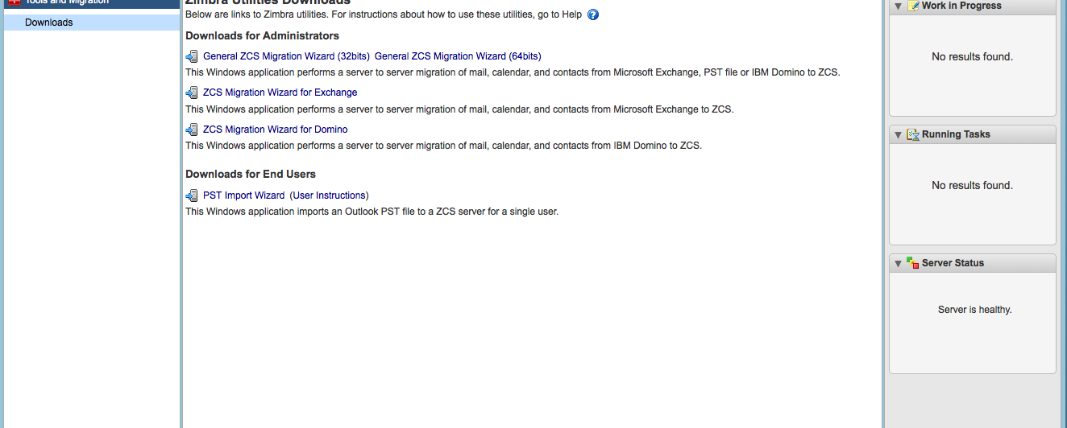
Localization
These links are being generated by the installer and appended to the ZaMsg.properties
I cannot seem to find the constants for these links in any of the *.properties files

Slide 37
Browser support
Same as mail UI
Firefox (works best)
Chrome (works)
Safari (mostly works as long as it works in Chrome)
IE (a pain)
No mobile version

Slide 38
Themes
Almost same as mail UI
ZimbraWebClient/WebRoot/admin_skins
defines layout outside of XForms
can be overwritten in web.xml (zimbraDefaultAdminSkin)
can be overwritten with ?skin={theme name} query parameter
name of the currently loaded skin is saved in ZA_SKIN cookie
consists of skin.html, skin.js, images, logos, manifest file, properties file, CSS file
Current skin created by Charles’ team in China

Slide 39
Admin Extensions
Intent:
separate network code from FOSS code
allow extending the Admin Console in any possible way (add/remove controls to/from any form, tie into external data sources, add entire new sections)
Kind of like a virus
no security
partially implemented, unenforced integration hooks

Slide 40
Admin Extensions UI
Integration Hook Example (ZaTabView.js):
(function that returns metadata for rendering a form)
ZaTabView.prototype.getMyXForm = function (entry) {
var xFormObject = new Object();
//Instrumentation code start
if(ZaTabView.XFormModifiers[this._iKeyName]) {
var methods = ZaTabView.XFormModifiers[this._iKeyName];
var cnt = methods.length;
for(var i = 0; i < cnt; i++) {
if(typeof(methods[i]) == "function") {
methods[i].call(this,xFormObject,entry);
}
}
}
//Instrumentation code end
return xFormObject;
}
Empty metadata object
Form name
Iterate through registered “modified” functions
Return metadata object

Slide 41
Admin Extensions UI
Integration Hook Example (ZaItem.js):
(function that submits a modified data object such as Account, Server, Domain, etc to the server)
ZaItem.prototype.modify = function (mods, tmpObj) {
//Instrumentation code start
if(ZaItem.modifyMethods[this._iKeyName]) {
var methods = ZaItem.modifyMethods[this._iKeyName];
var cnt = methods.length;
for(var i = 0; i < cnt; i++) {
if(typeof(methods[i]) == "function") {
methods[i].call(this, mods, tmpObj);
}
}
}
//Instrumentation code end
}

Slide 42
Admin Extensions UI
Integration Example (ZaServer.js):
(registering a funciton that submits Server object modifications to the server)
ZaServer.modifyMethod = function (tmpObj) {
...
//actually send JSON request to the server
var params = new Object();
params.soapDoc = soapDoc;
var reqMgrParams = {
controller : ZaApp.getInstance().getCurrentController(),
busyMsg : ZaMsg.BUSY_MODIFY_SERVER
}
var resp = ZaRequestMgr.invoke(params, reqMgrParams).Body.ModifyServerResponse;
this.initFromJS(resp.server[0]);
}
ZaItem.modifyMethods["ZaServer"].push(ZaServer.modifyMethod);

Slide 43
Admin Extensions UI
Loading
via AjxInclude
single gzippped file in production mode (/service/zimlet/res/Zimlets-nodev_all.js.zgz)
one by one in dev mode
GetAdminExtensionZimletsRequest returns the list of zimlet objects
ZaSettings.init loads each JS and CSS file
current admin user has to have getZimlet permission to every admin extension that needs to be loaded in dev mode
errors in admin extensions can make Admin Console fail to load
usually follow the same MVC design pattern as the rest of Admin Console code
use hooks to add UI elements and extend data models

Slide 44
Admin Extensions UI
Example:
com_zimbra_backuprestore extension adds 4 new fields to Server object data model (com_zimbra_backuprestore.js)
if(ZaServer) {
ZaServer.A_zimbraBackupMode = "zimbraBackupMode";
ZaServer.A_zimbraBackupAutoGroupedThrottled = "zimbraBackupAutoGroupedThrottled";
ZaServer.A_zimbraBackupAutoGroupedNumGroups = "zimbraBackupAutoGroupedNumGroups";
ZaServer.A_zimbraBackupMinFreeSpace = "zimbraBackupMinFreeSpace";
if(ZaServer.myXModel) {
ZaServer.myXModel.items.push({id:ZaServer.A_zimbraBackupMode, ref:"attrs/" +
ZaServer.A_zimbraBackupMode, type:_COS_STRING_});
ZaServer.myXModel.items.push({id:ZaServer.A_zimbraBackupAutoGroupedNumGroups, ref:"attrs/" +
ZaServer.A_zimbraBackupAutoGroupedNumGroups, type:_COS_NUMBER_});
ZaServer.myXModel.items.push({id:ZaServer.A_zimbraBackupAutoGroupedThrottled, ref:"attrs/" +
ZaServer.A_zimbraBackupAutoGroupedThrottled, type:_COS_ENUM_, choices:ZaModel.BOOLEAN_CHOICES});
ZaServer.myXModel.items.push({id:ZaServer.A_zimbraBackupMinFreeSpace,ref:"attrs/” +
ZaServer.A_zimbraBackupMinFreeSpace, type:_COS_STRING_});
}
}

Slide 45
Admin Extensions UI
Example:
com_zimbra_backuprestore extension adds a tab with a bunch of fields to Global Config form
ZaHotBackup.GlobalConfigXFormModifier = function (xFormObject, entry) {
var tabBar = xFormObject.items[1] ;
ZaHotBackup.GlobalConfigTabIndex = ++this.TAB_INDEX;
tabBar.choices.push({value:ZaHotBackup.GlobalConfigTabIndex , label:com_zimbra_backuprestore.BNR_Tab_BNR});
var backupTabView = { ... }
for (var i=0;i<xFormObject.items.length;i++) {
if(xFormObject.items[i].type=="switch") {
xFormObject.items[i].items.push(backupTabView);
break;
}
}
};
if(ZaTabView.XFormModifiers["GlobalConfigXFormView"]) {
ZaTabView.XFormModifiers["GlobalConfigXFormView"].push(ZaHotBackup.GlobalConfigXFormModifier);
};

Slide 46
Admin Extensions Examples
Where they are hiding:
com_zimbra_backuprestore: ZimbraBackup/src/zimlet/
com_zimbra_cert_manager: ZaAdminExt/CertificateMgr/js/
com_zimbra_delegatedadmin: ZimbraNetwork/ZimbraAdminExt/DelegatedAdmin/js/
com_zimbra_viewmail: ZimbraNetwork/ZimbraAdminExt/com_zimbra_viewmail/js/
com_zimbra_cluster: ZimbraCluster/src/zimlet/
com_zimbra_hsm: ZimbraHSM/src/zimlet/
com_zimbra_bulkprovision (aka we-based migration wizard): ZaAdminExt/BulkProvision/js/
com_zimbra_adminversioncheck: ZimbraAdminVersionCheck/src/zimlet/
com_zimbra_xmbxsearch (aka cross-mailbox search): ZimbraXMbxSearch/src/admin_extension/com_zimbra_xmbxsearch/
com_zimbra_ucconfig (aka Voice/Chat service): ZimbraNetwork/ZimbraAdminExt/com_zimbra_ucconfig/js/

Slide 47
Admin Extensions :: Server Components
Most admin extensions require server extensions that implement additional SOAP request handlers:
VersionCheckRequest
InstallCertRequest
GetCertRequest
GenCSRRequest
BulkImportAccountsRequest
BulkIMAPDataImportRequest
GetXMbxSearchRequest
GetXMbxSearchesListRequest
These are packaged in jar files and dropped into /opt/zimbra/lib/ext
jetty picks them up, finds DocumentService implementation and calls registerHandlers method
When server returns UNKNOWN_DOCUMENT that usually means that the server extension failed to load properly and SOAP handler was not registered
Ask Server team for more info on how to implement server extensions

Slide 48
Admin Extensions :: FOSS vs Network
Nothing prevents a Network extension from being loaded in a FOSS
Network Server extensions may not work in FOSS
Network extensions that will work in FOSS just fine:
deletaged admin
view mail
Network extensions that will load, but will not be fully functional in FOSS
cross mailbox Search
license
backup
HSM
convertd
cluster

Slide 49
Dev environment
To deply a dev build:
$ant admin-deploy
To deploy a production war file:
$ant prod admin-deploy
If you built web client, you have to run “clean” target before building admin war, otherwise the templates get messed up
To make a production build load separate JS files instead of gzipped bundles add ?dev=1
?dev=1 also opens a popup window with debug trace, but it is not very useful – FireBug is far more useful
default admin login/password is admin/test123
do not use zimbra/test123 to log in to admin UI

Slide 50
Areas to focus on next
Client side data caching
expecially broken in Iron Maden
no good UI support for concurrent modification
Managing asynchronous requests
still a few synchronous requests for no good reason
Admin extensions framework
poorly written extensions break the UI
PS often stumbles trying to write extensinos because there is no good documentation
customers shoot themselves in the foot by installing 3rd party extensions
Popup wizards need to go
Talk to the users
Add metrics/analytics

Slide 51
Widescreen Test Pattern (16:9)
Aspect Ratio Test
(Should appear circular)
4x3
16x9

